Slide 1
Transformers
Attention Is All You Need

Slide 2
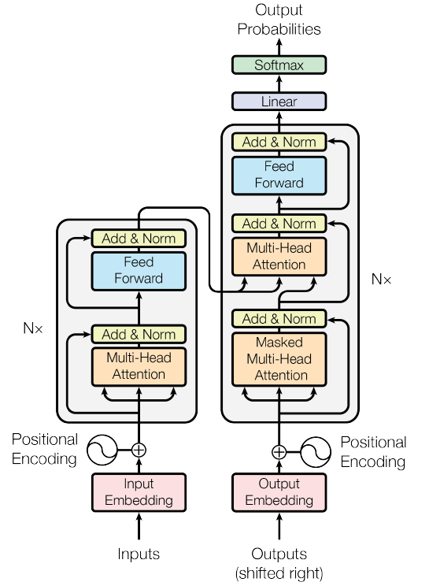
Understanding Transformers Architecuter
“A transformer model is a neural network that learns context and thus meaning by tracking relationships in sequential data like the words in this sentence. “
March 25, 2022 by Rick Merritt.

Slide 3
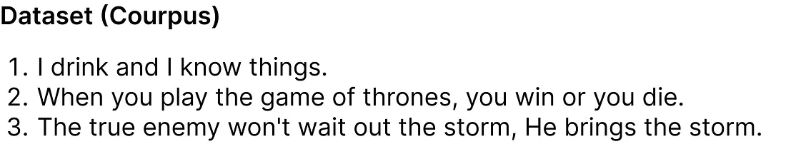
Defining the data
The initial step is to define our dataset (corpus).
In our dataset, there are 3 sentences (dialogues) taken from the Game of Thrones TV show. Although this dataset may seem small, its size actually helps us in finding the results using the upcoming mathematical equations.

Slide 4

Data for Training

Slide 5
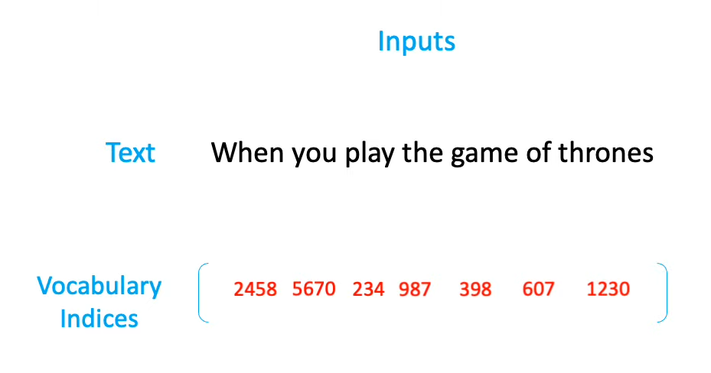
Inputs and Numeric Indices

Slide 6
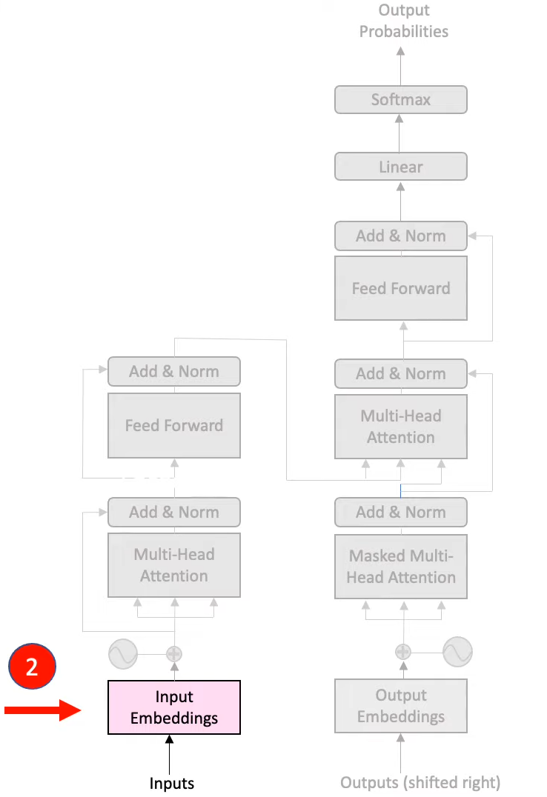
Embedding Layer
Each word passed as input will be represented as an encoded integer, and each corresponding integer value will have an associated embedding attached to it.
These embedding can be find using Google Word2vec (vector representation of word). In our numerical example we will suppose embedding vector for each word filled with random values between (0 and 1).
Moreover, the original paper use 512 dimension of embedding vector, we will consider a very small dimension i.e., 5 for numerical example.

Slide 7
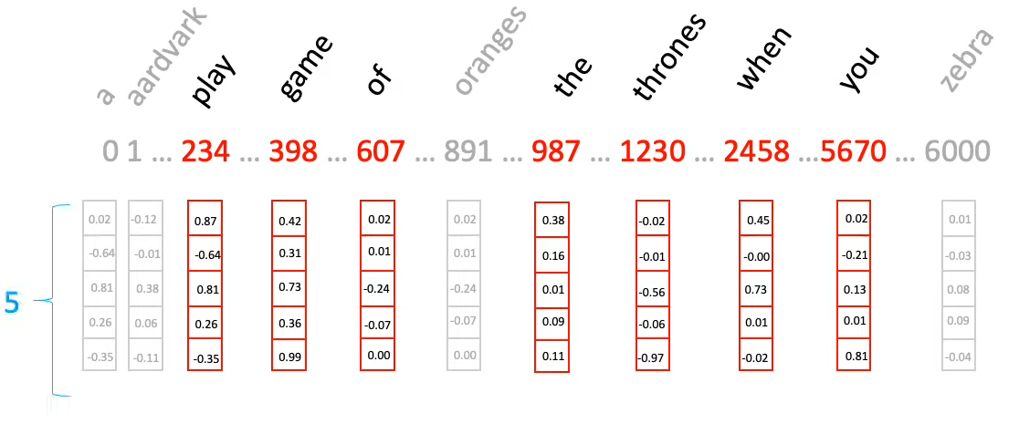
Embedding Layer Working

Slide 8
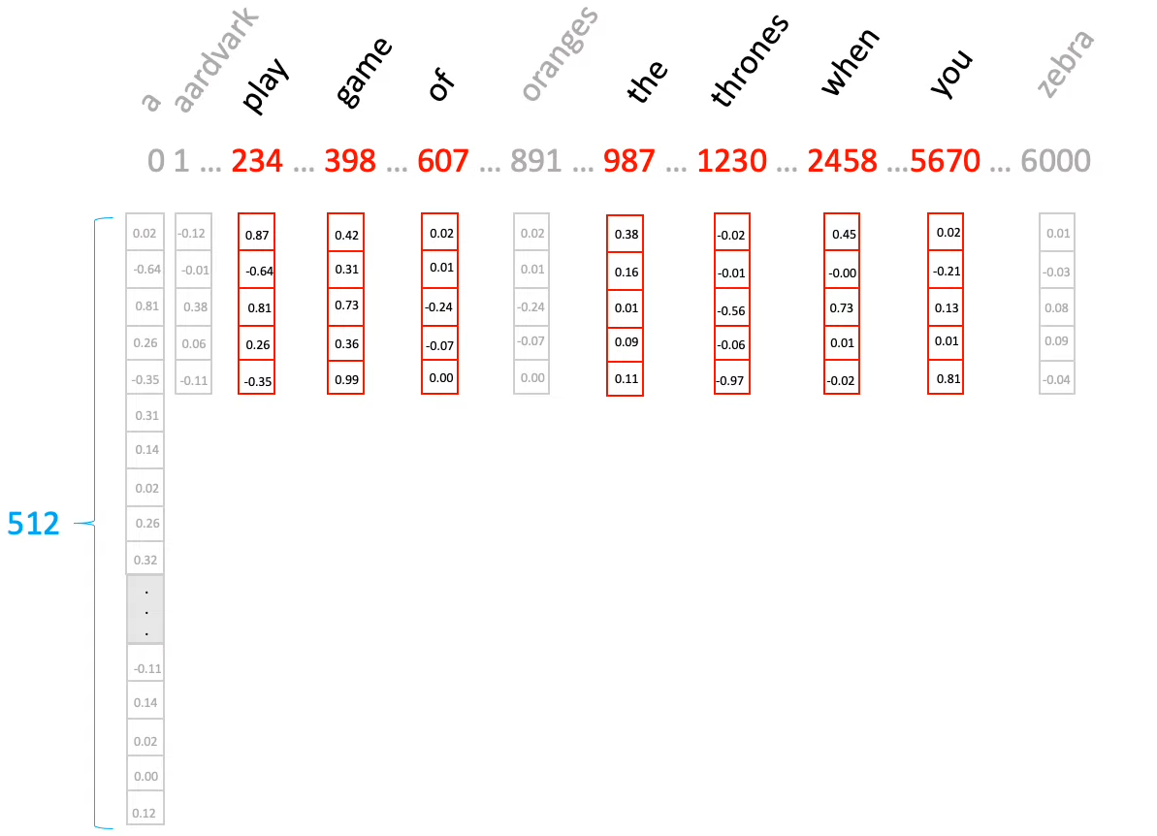
Embeddings Layer (Attention is All You Need)

Slide 9
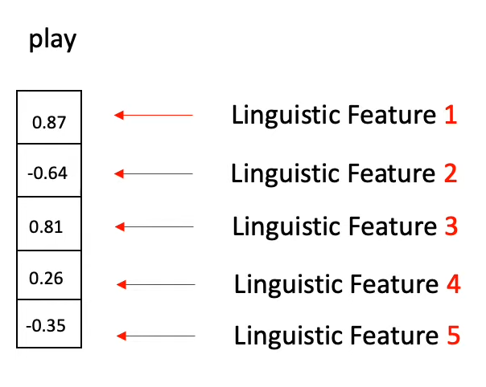
What is Embedding
It is a vector representation of word with some linguistic features

Slide 10
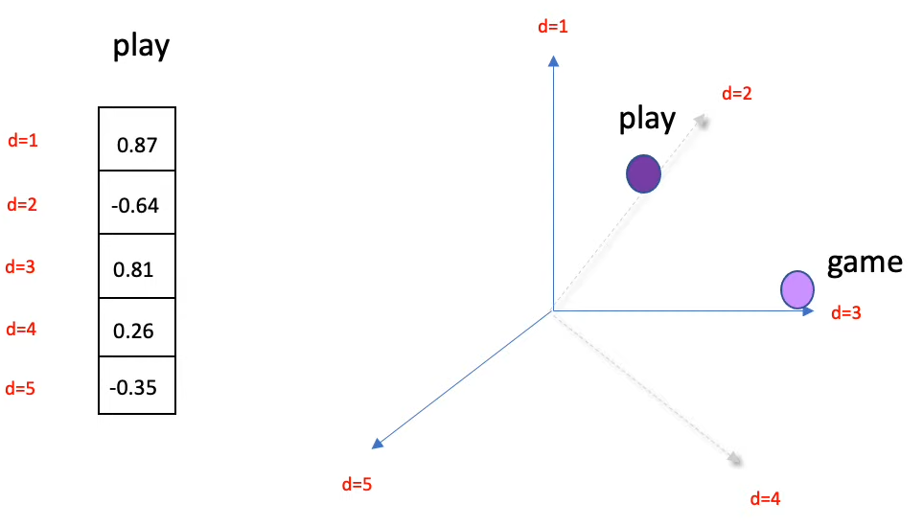
Representing Embeddings (Before Training)

Slide 11
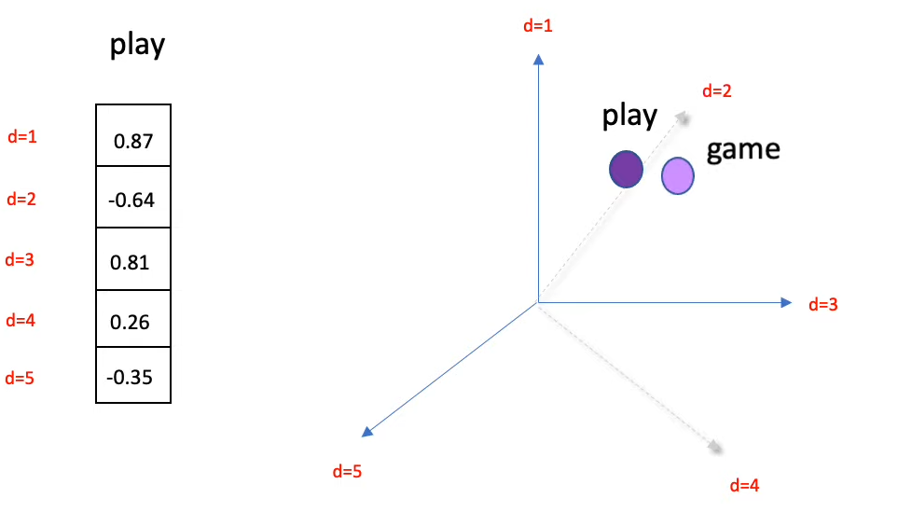
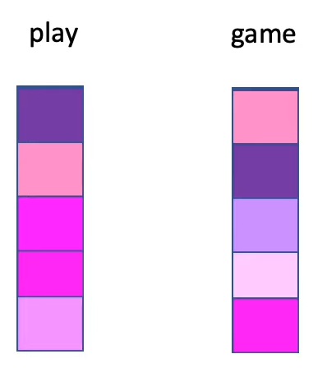
Representing Embeddings (After Training)

Slide 12
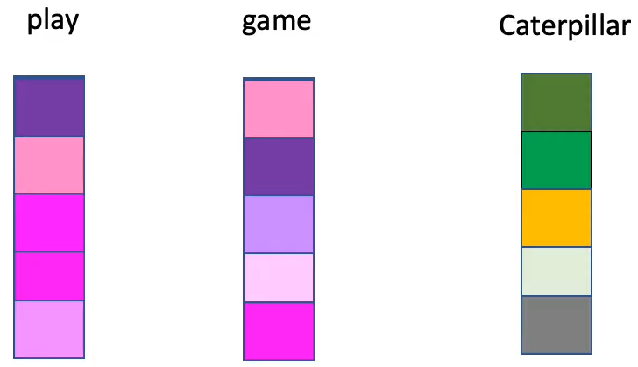
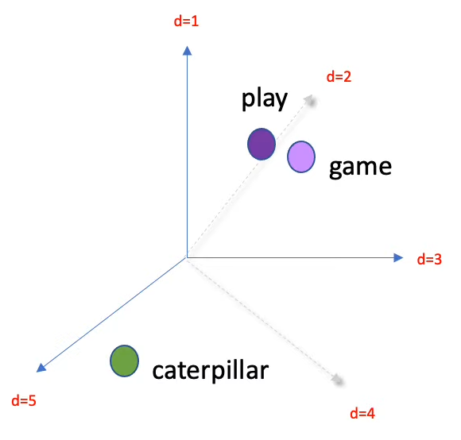
Contd...

Slide 13
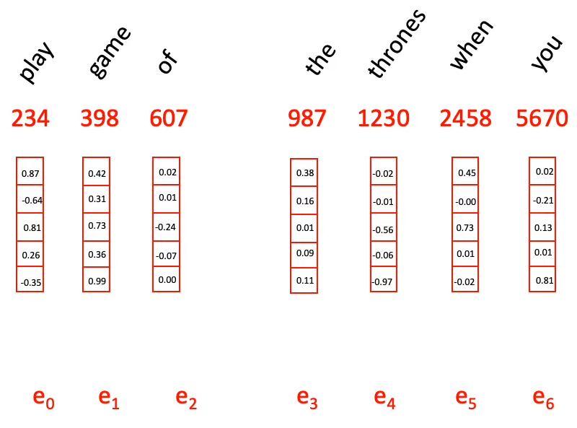
Contd...

Slide 14
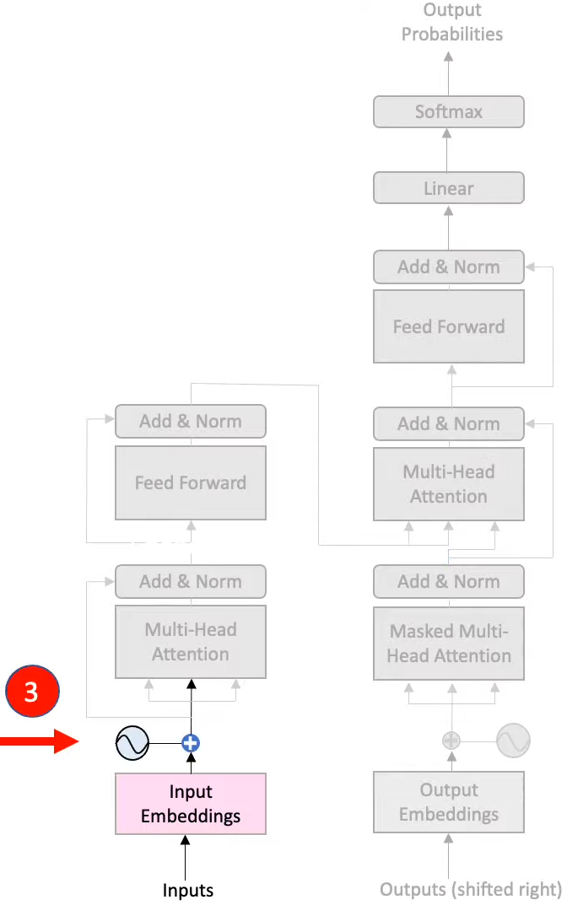
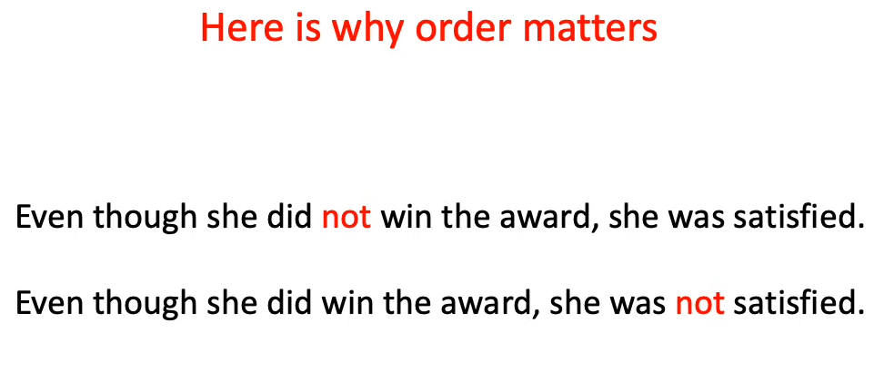
Positional Embedding
Positional Embeddings are use to train the model as per the positions of words in the sentences. Without this our model can predict words but can`t maintain the sementical meaning.

Slide 15
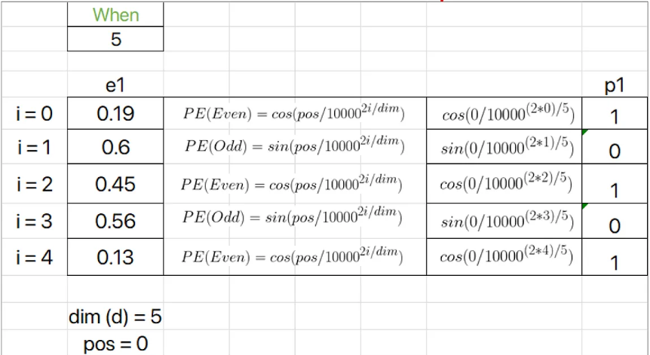
How to calculate Positional Embedings
234
0.42
0.31
0.73
0.36
0.99

Slide 16
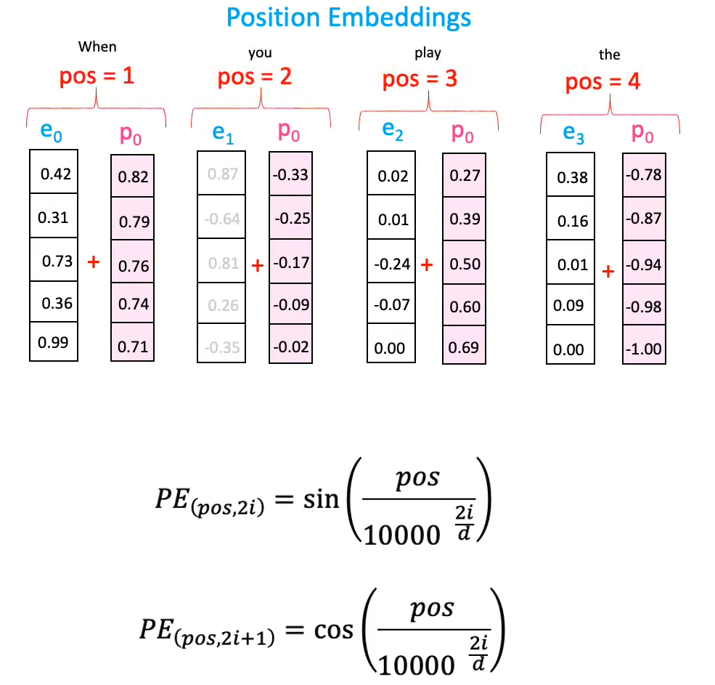

Slide 17
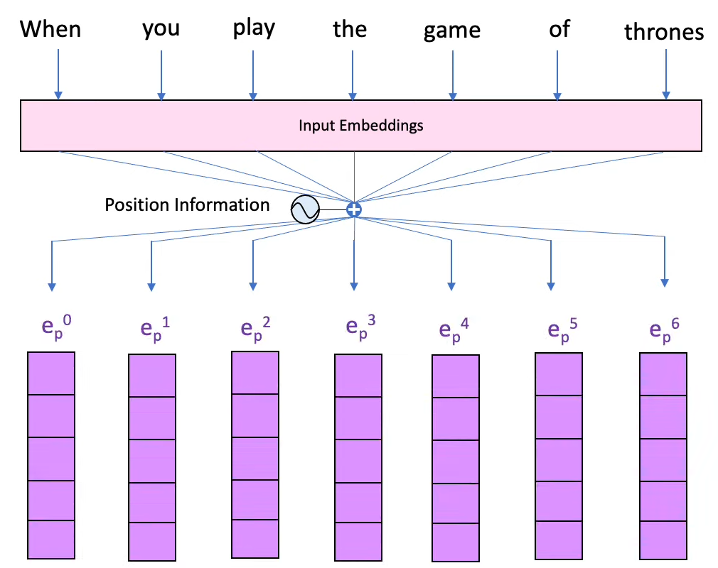
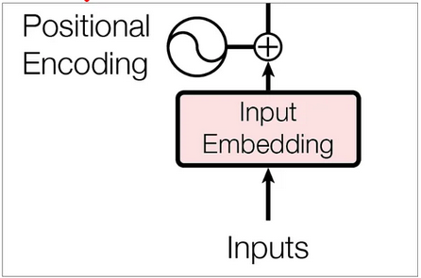
Recap

Slide 18
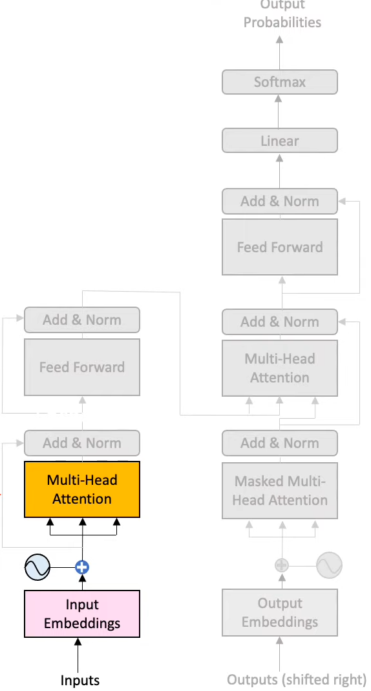
Encoder
In the encoder, we perform complex operations involving matrices of queries, keys, and values. These operations are crucial for transforming the input data and extracting meaningful representations.

Slide 19
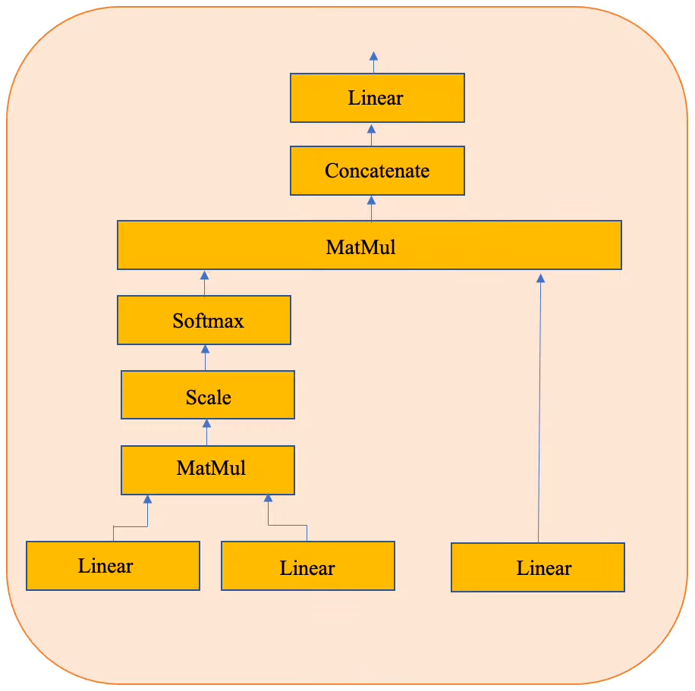
Multi-Head Attention
Inside the multi-head attention mechanism, a single attention layer consists of several key components.
There are three inputs in attention layer:
Query
Key
Value

Slide 20
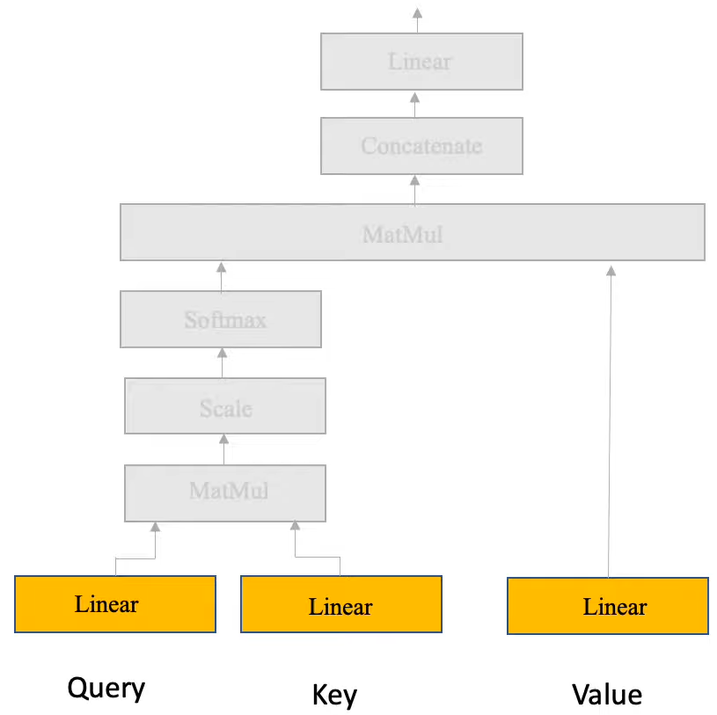

Slide 21
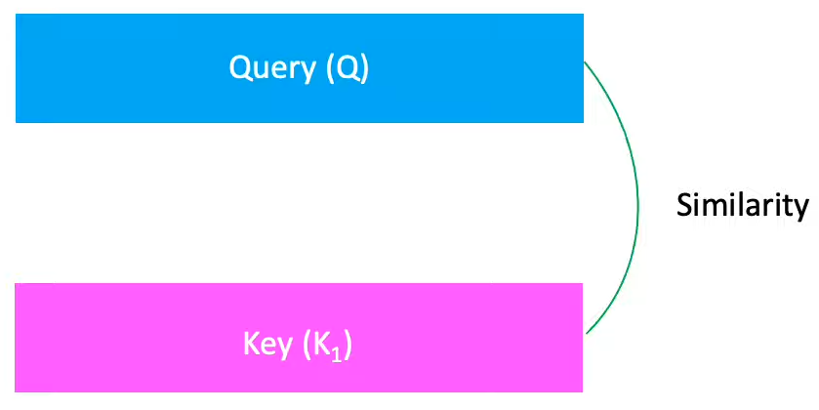
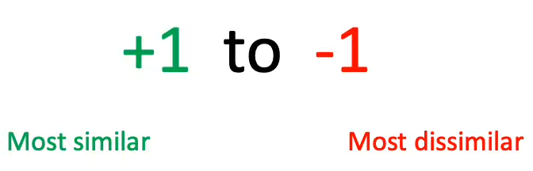
Cosine Similarity

Slide 22
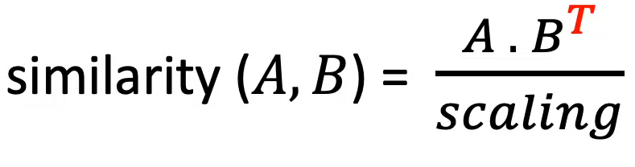
Similarity b/w Matrices

Slide 23
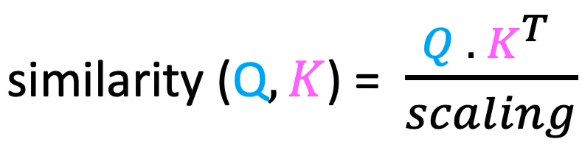
Similarity b/w Query and Key

Slide 24
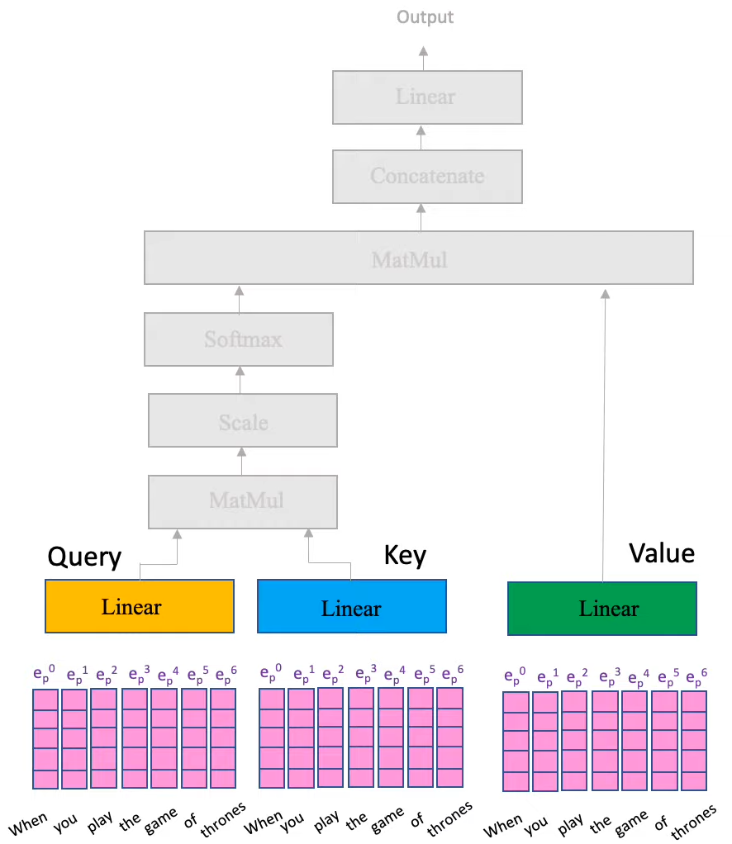

Slide 25
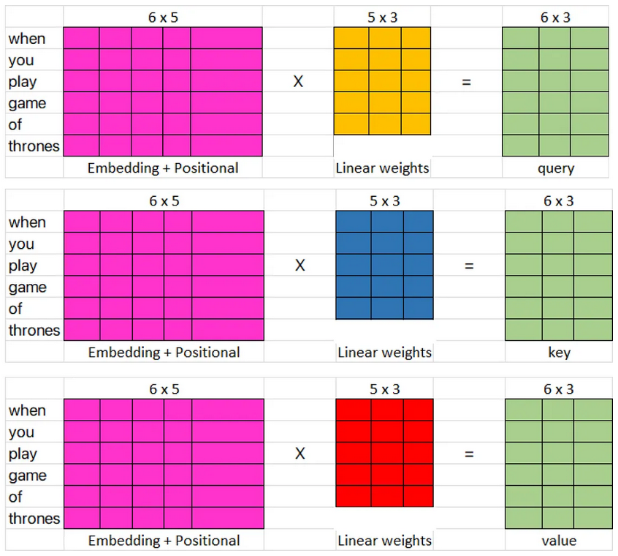

Slide 26
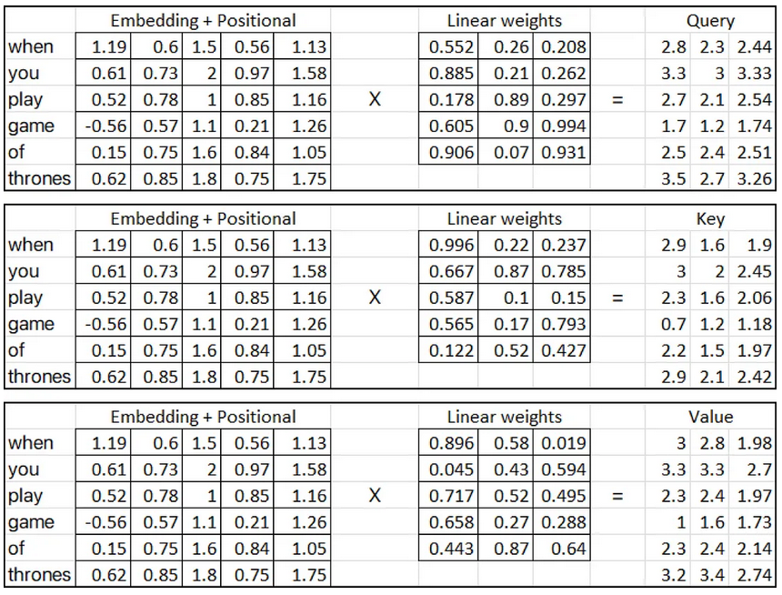

Slide 27
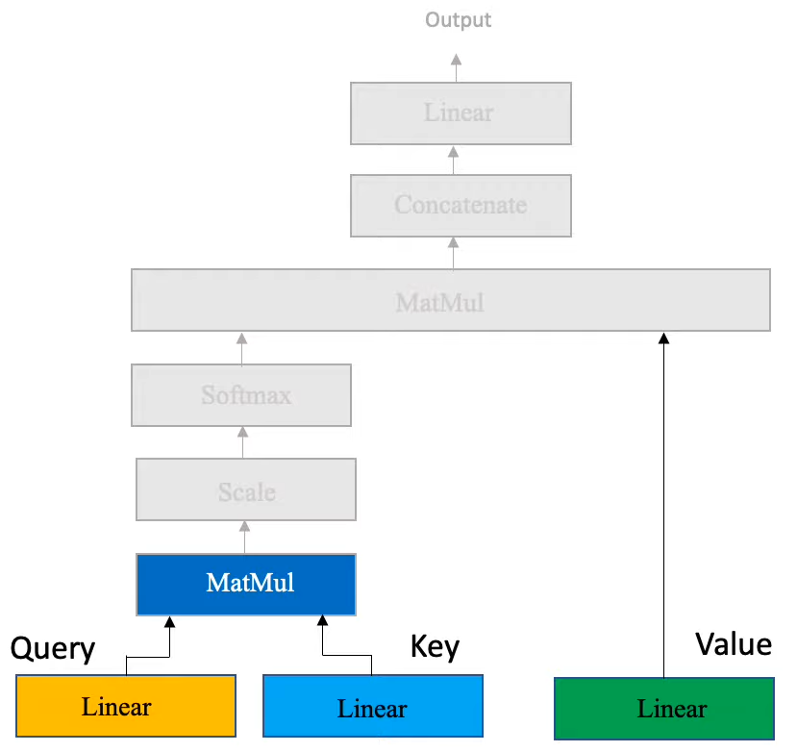

Slide 28
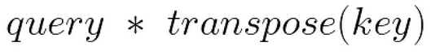
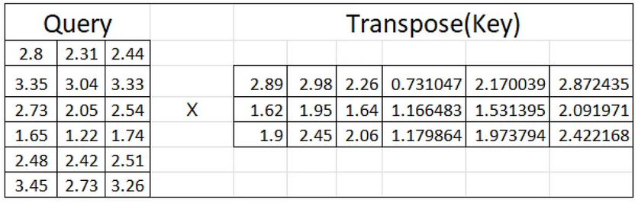
Matrix Multiplication

Slide 29
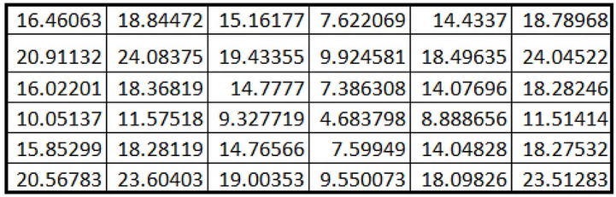
Matrix Multiplication

Slide 30
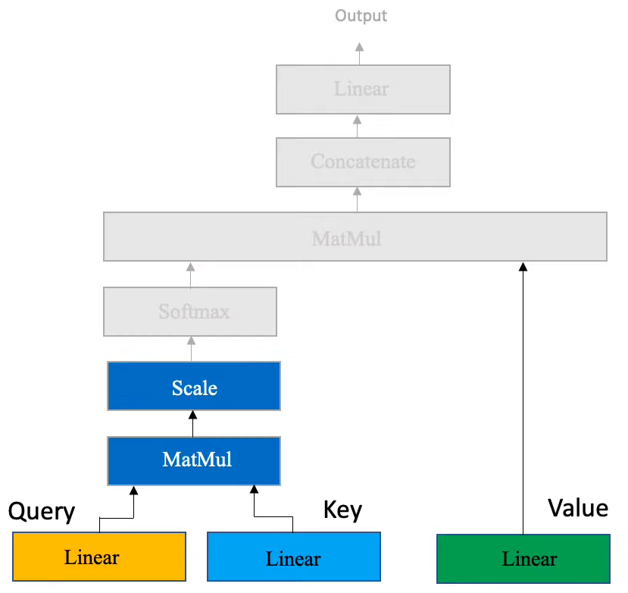
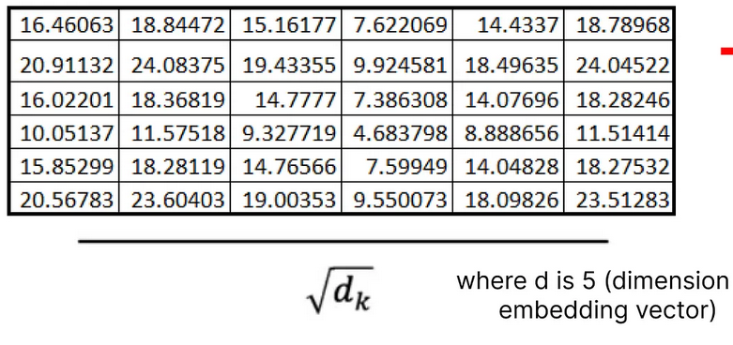
Scaling

Slide 31
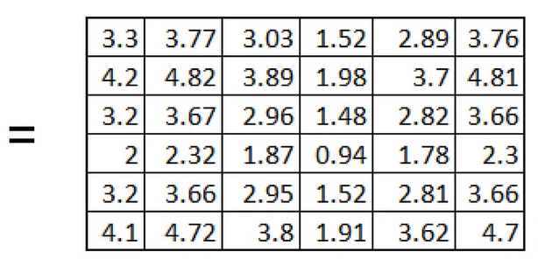
Scaling Result

Slide 32
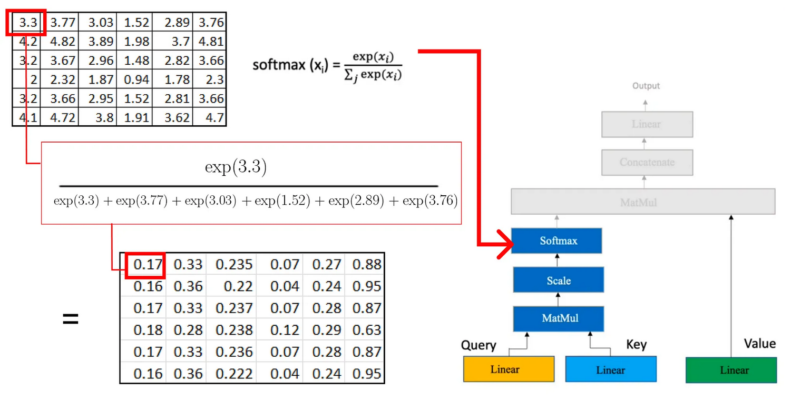
Softmax

Slide 33
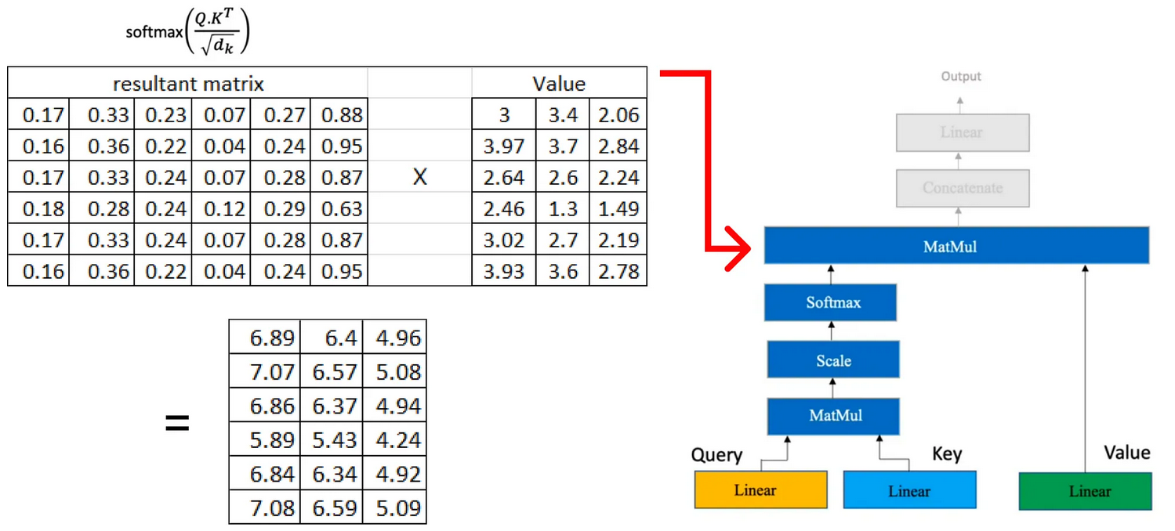
MatMul Again

Slide 34
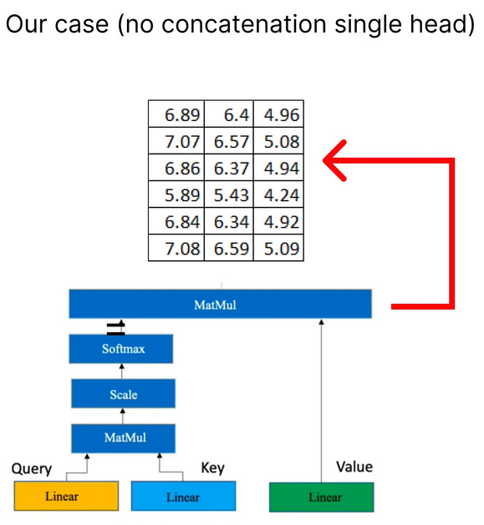
Attention

Slide 35
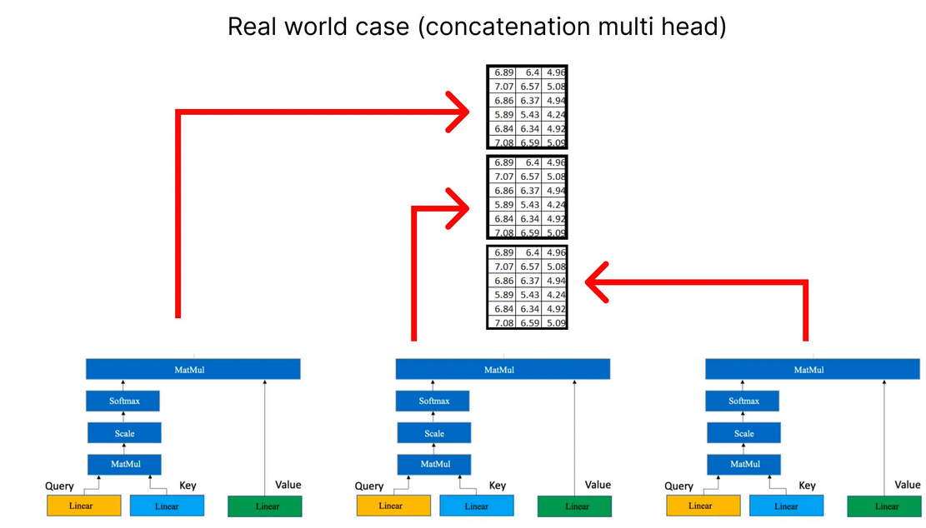
Multi-Head Attention

Slide 36
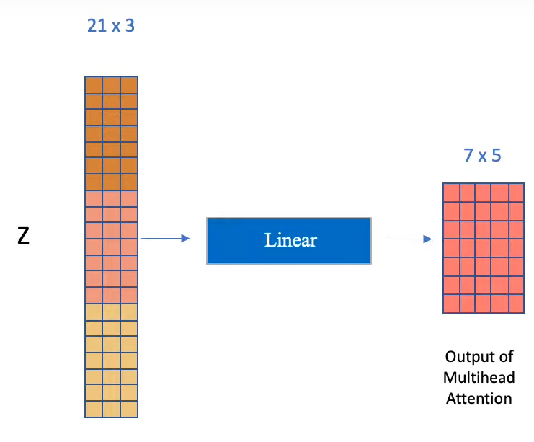
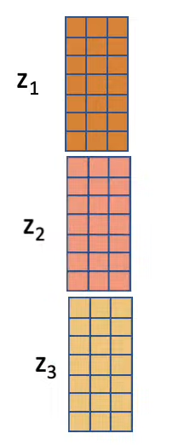
Concatenation

Slide 37
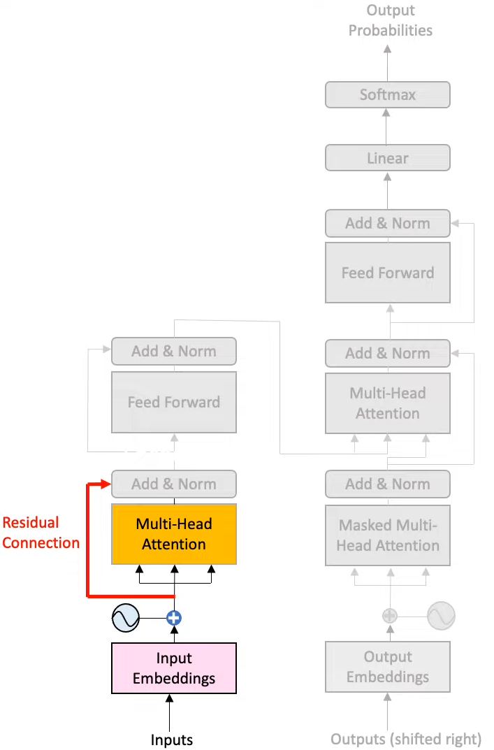
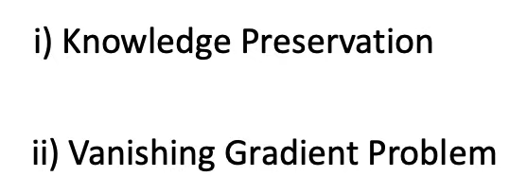
Residual Connection

Slide 38
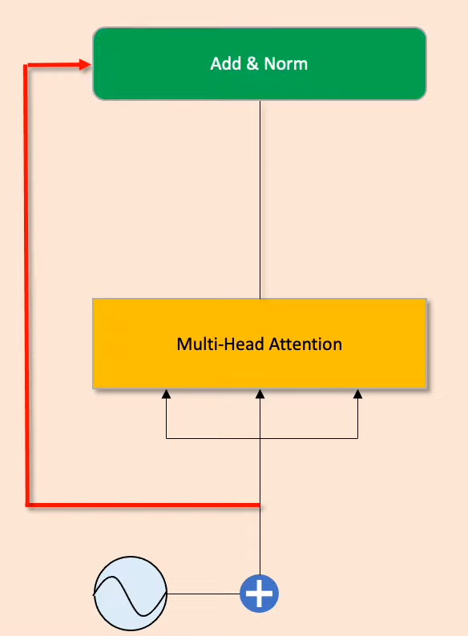
Add and Norm Layer

Slide 39
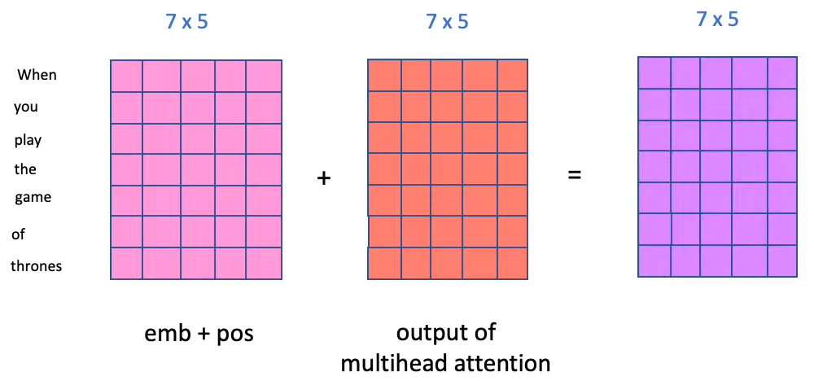
Add
Add Embedding+Position(Residual Connection) and Output of Multihead attention

Slide 40
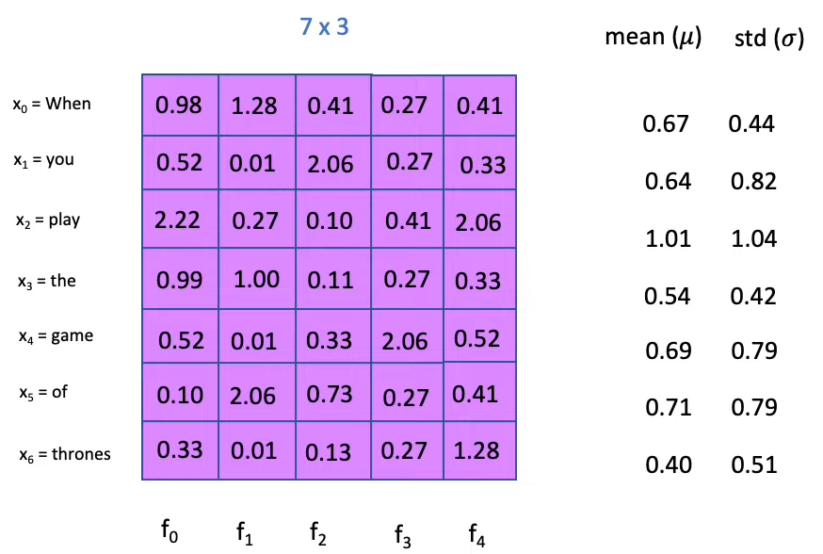
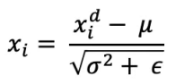
Normalization
7x5
Make Convergence faster and more stable

Slide 41
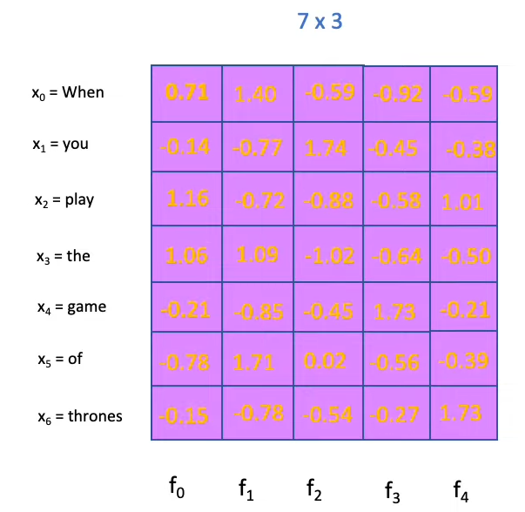
Norm Result
7x5

Slide 42
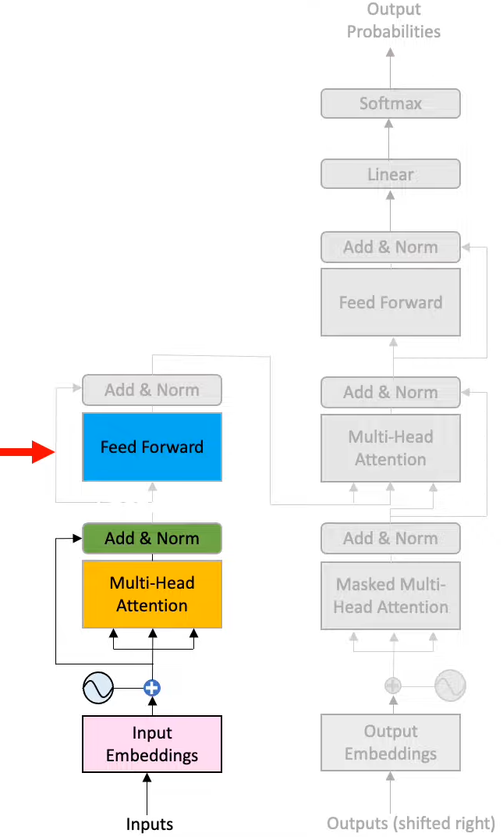

Feed Forward

Slide 43
Decoder

Slide 44


Decoder

Slide 45
Masking

Slide 46

Masking Contd...
We will add masking just before Softmax in multi-head attention mechanism

Slide 47


Slide 48


Decoder Contd...

Slide 49

Contd...

Slide 50

Contd...

Slide 51



Output Embeddings
We pass the previous output of decoder to the next decoder input

Slide 52
References
https://youtu.be/dichIcUZfOw?list=PL86uXYUJ7999zE8u2-97i4KG_2Zpufkfb
https://youtu.be/mMa2PmYJlCo?list=PL86uXYUJ7999zE8u2-97i4KG_2Zpufkfb
https://youtu.be/gJ9kaJsE78k

